Slide 1
Learning Genetic History with PCA

Slide 2
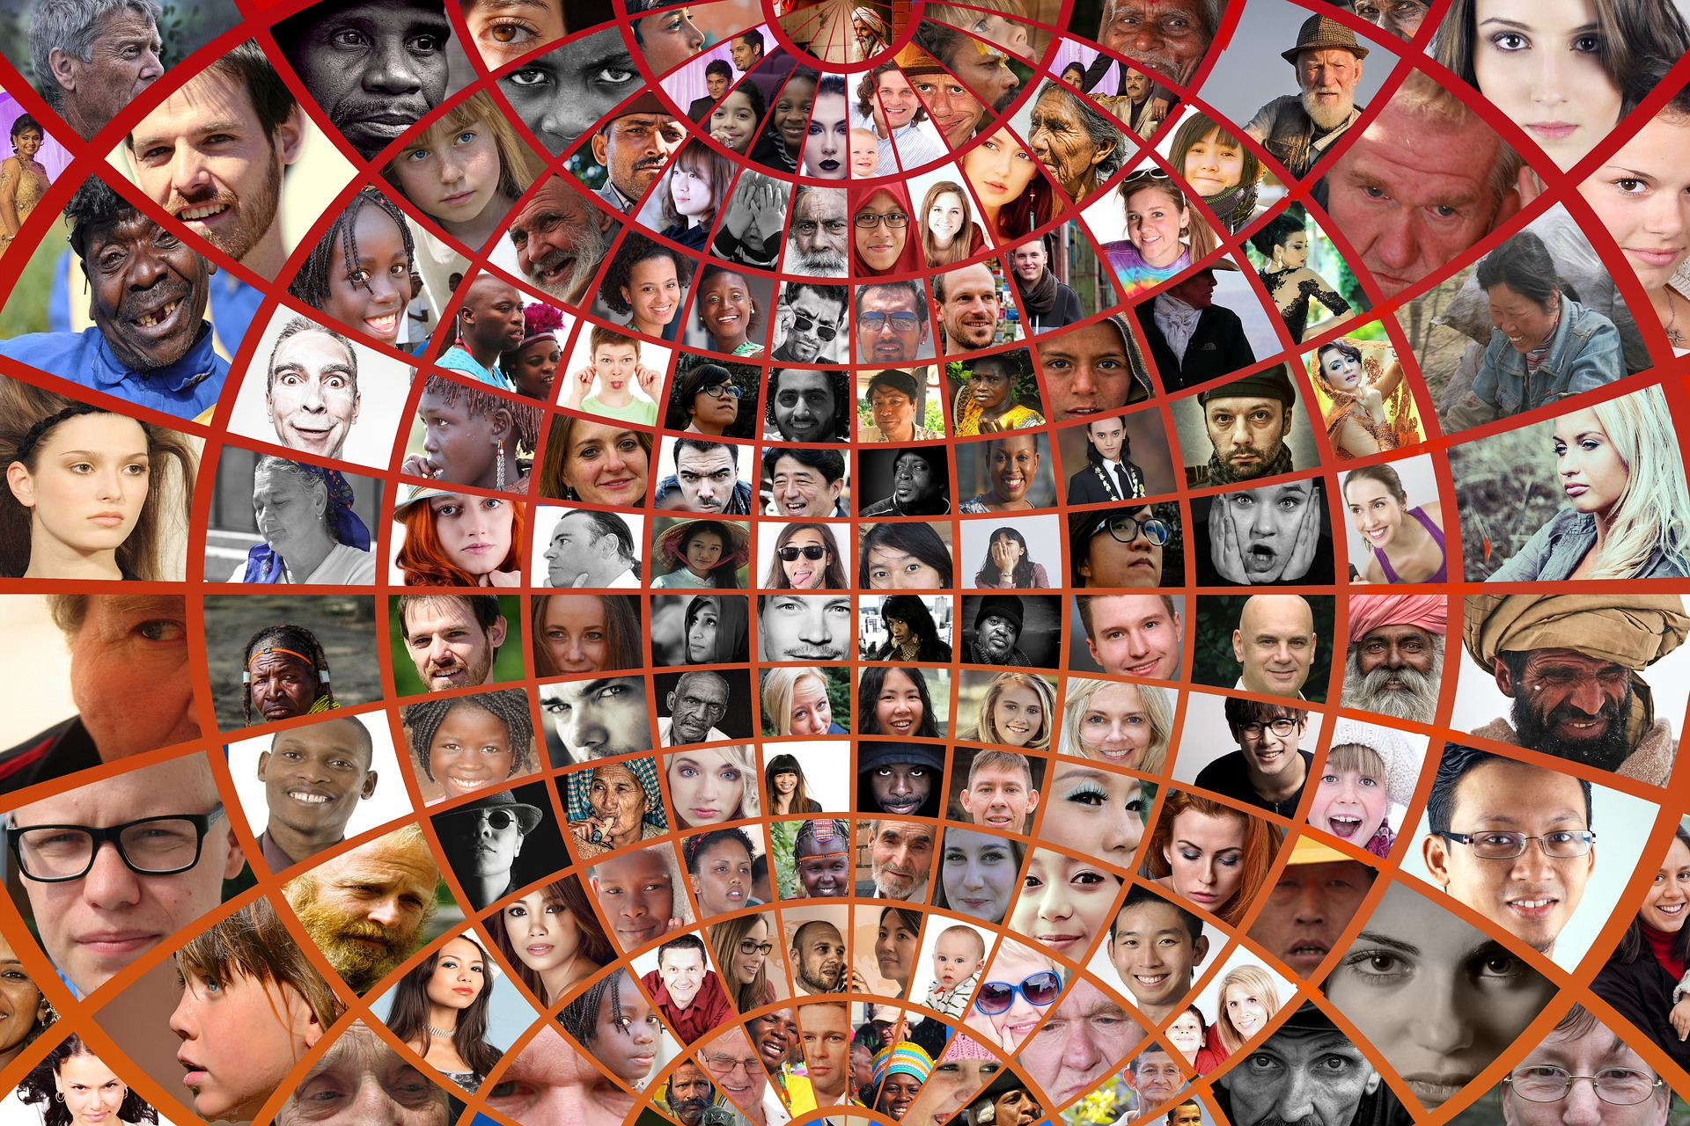
Diversity and History

Slide 3
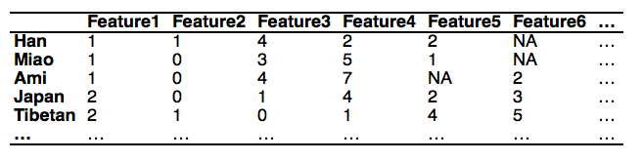
Infer History from Diversity

Slide 4
PCA for Dimension Reduction
transforms the data to a new coordinate system
greatest variance by some projection of the data comes to lie on the first coordinate

Slide 5
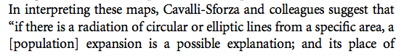

Menozzi 1978 Science
Cavalli-Sforza 1993 Science
Cavalli-Sforza 1994 The History and Geography of Human Genes

Slide 6
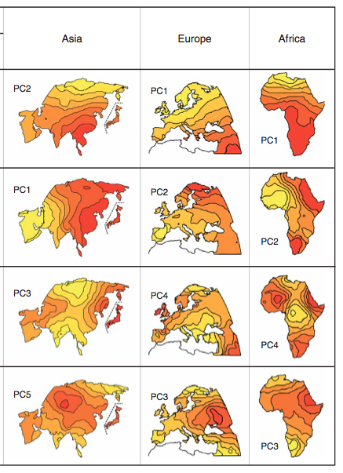
Novembre 2008 Nat. Genet.

Slide 7
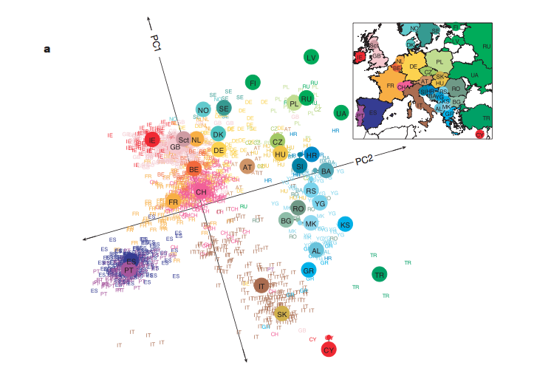
Gene and Geography
Novembre 2008 Nature

Slide 8
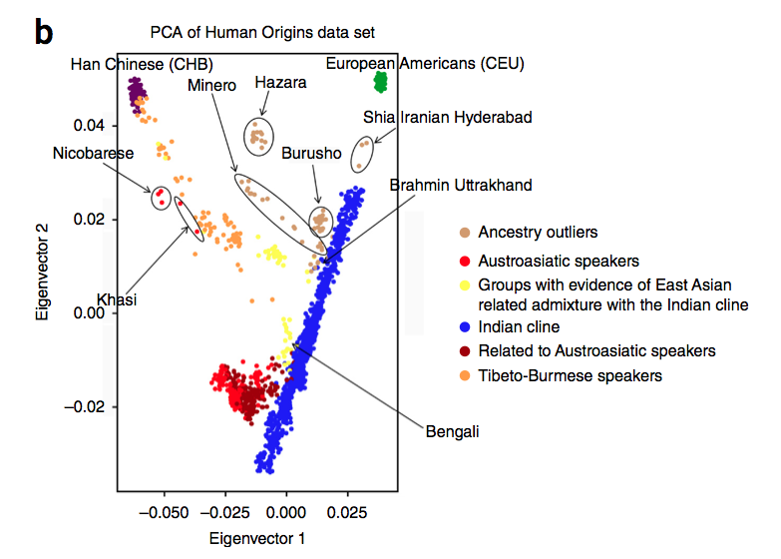
PCA Insight into Admixture
Nakatusuka 2017 Nat. Genet.

Slide 9
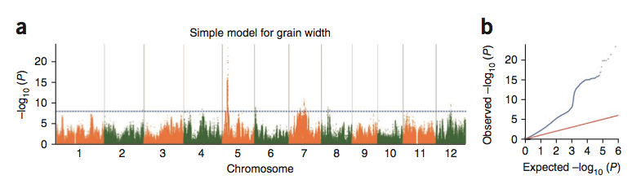
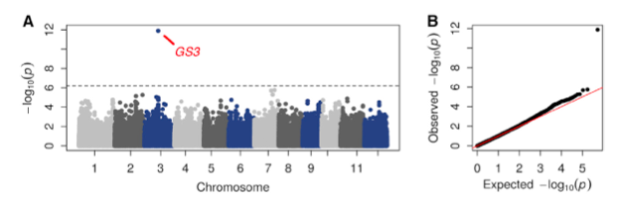
Control for Structure in Association Studies

Slide 10
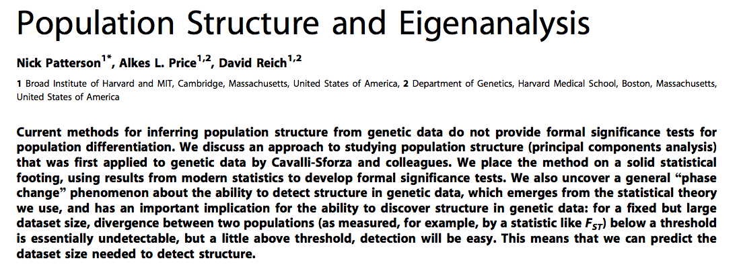
SmartPCA: https://github.com/DReichLab/EIG/blob/master/POPGEN/README

Slide 11
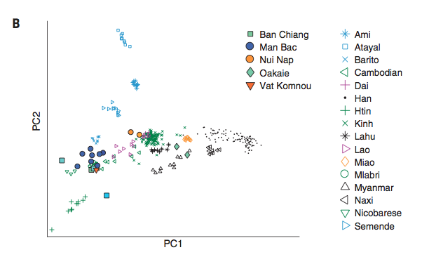
Exercise
Lipson 2018 Science

Slide 12
Homework
Play with SEA dataset using PCA, write a few comments on the feature/history of any of the populations that you learned from PCA results, and explain why you think so.
Replicate Haak’s Figure 2a. Write a few comments on the results.

